Slide 1

A
FINAL YEAR PROJECT REPORT
On
Title : Human Resource Management System
Submitted in partial fulfilment of the requirements of the degree of
BACHELOR OF TECHNOLOGY
Group Name - The Strange Developers
DEPARTMENT OF COMPUTER SCIENCE
TECHNO INDIA NJR INSTITUTE OF TECHNOLOGY, UDAIPUR
MAY 2024

Slide 2
Group Details
Name | Roll No. | Email | Branch & Year
Sanjay Menaria | 20ETCCS098 | sanjaymenaria.2020cs@technonjr.org | 4th year CSE
Sudhanshu Dengra | 20ETCCS106 | sudhanshudengra.2020cs@technonjr.org | 4th year CSE
Vineet Agarwal | 20ETCCS114 | vineetagarwal.2020cs@technonjr.org | 4th year CSE

Slide 3
Problem Statement
Managing human resources in an organization involves many tasks such as managing employee information, payroll, leave and bonus applications, ticket management, and reminders. The traditional manual methods used for these tasks are often time-consuming, prone to errors, and inefficient. A comprehensive Human Resource Management System (HRMS) is needed to automate and integrate various HR processes, minimize errors, reduce administrative overhead, and enhance the overall efficiency of HR management within the organization. The HRMS will bring all these tasks together, reducing mistakes, making things easier, and improving how we manage the team. It will automate and streamline the HR processes, making it faster, smarter, and more efficient, so that HR team members can focus on improving employee experiences, reducing costs, and driving the business forward.

Slide 4
Objectives and Scopes
Comprehensive HR System: The project aims to develop an all-encompassing Human Resource Management System with these key features:
User Authentication: Secure login system for authorized access.
Employee Data Management: Adding, modifying, and deleting employee records for accuracy.
Payroll Integration: Linking payroll processes within the system for streamlined payment management.
Leave and Bonus Applications: Providing functionality for employees to request leaves, loans, and bonuses.
Centralized Ticketing System: Managing various employee queries or concerns in one unified platform.
Enhancing HR Operations: By incorporating these features, the project seeks to simplify and optimize HR tasks, ultimately boosting overall organizational efficiency.

Slide 5
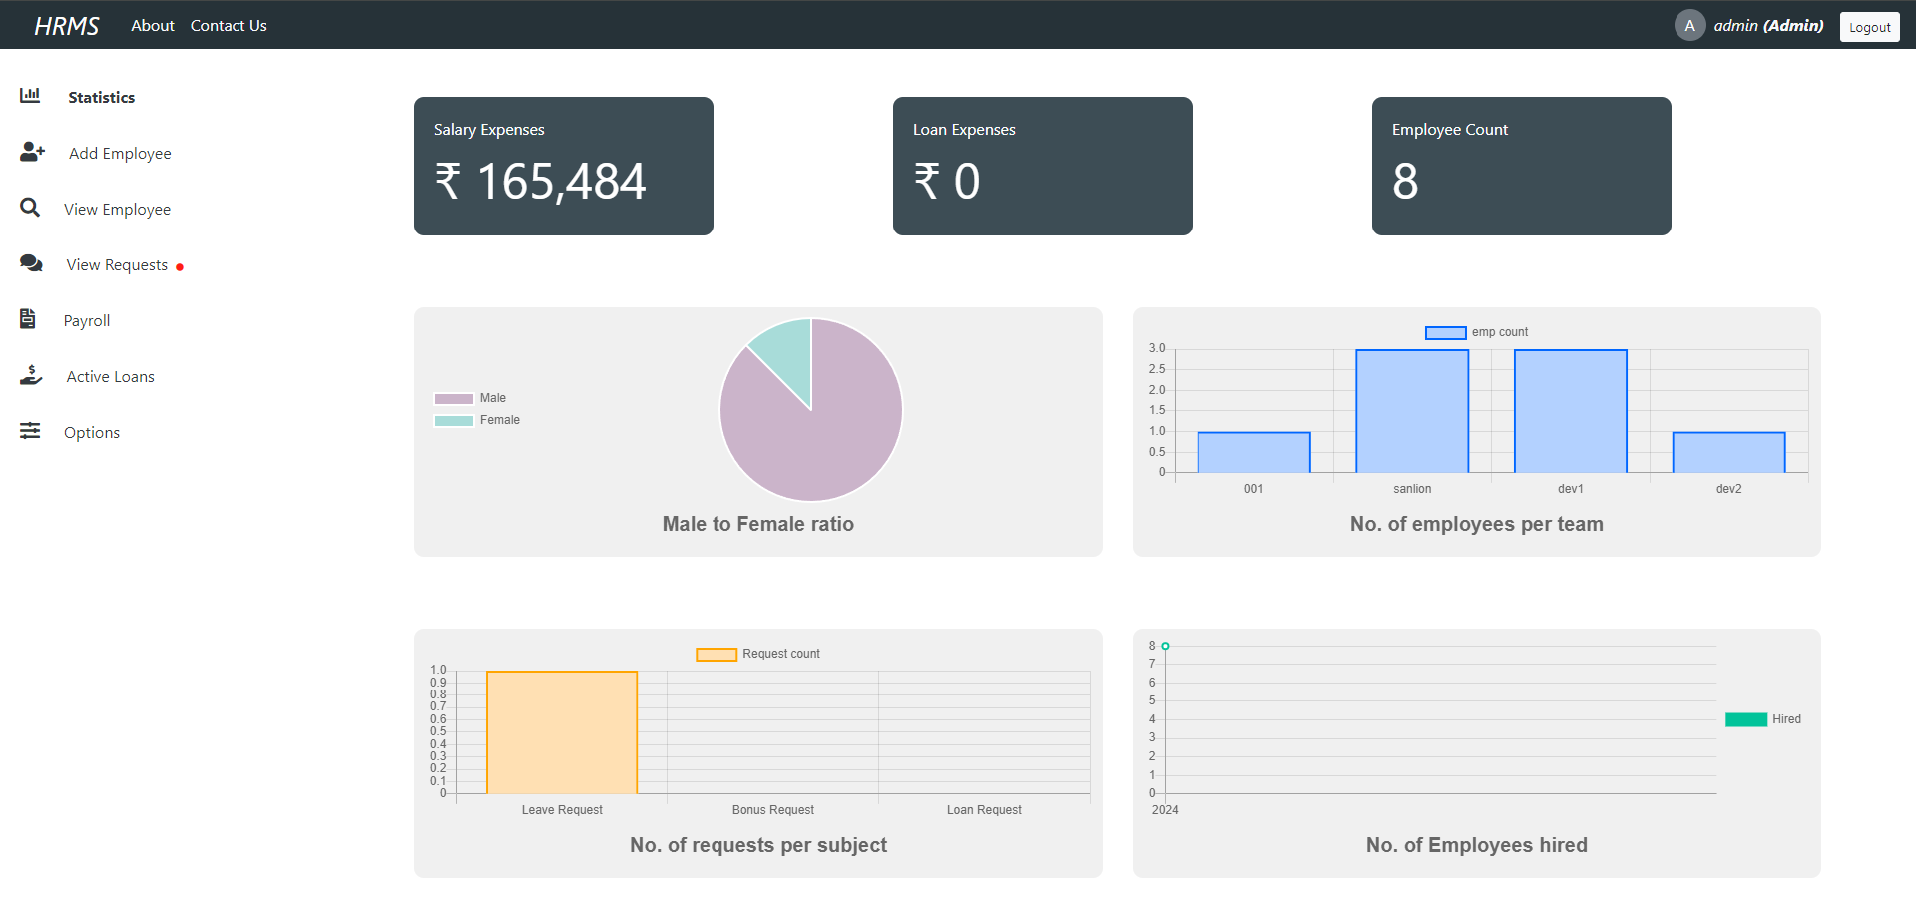
Admin

Slide 6
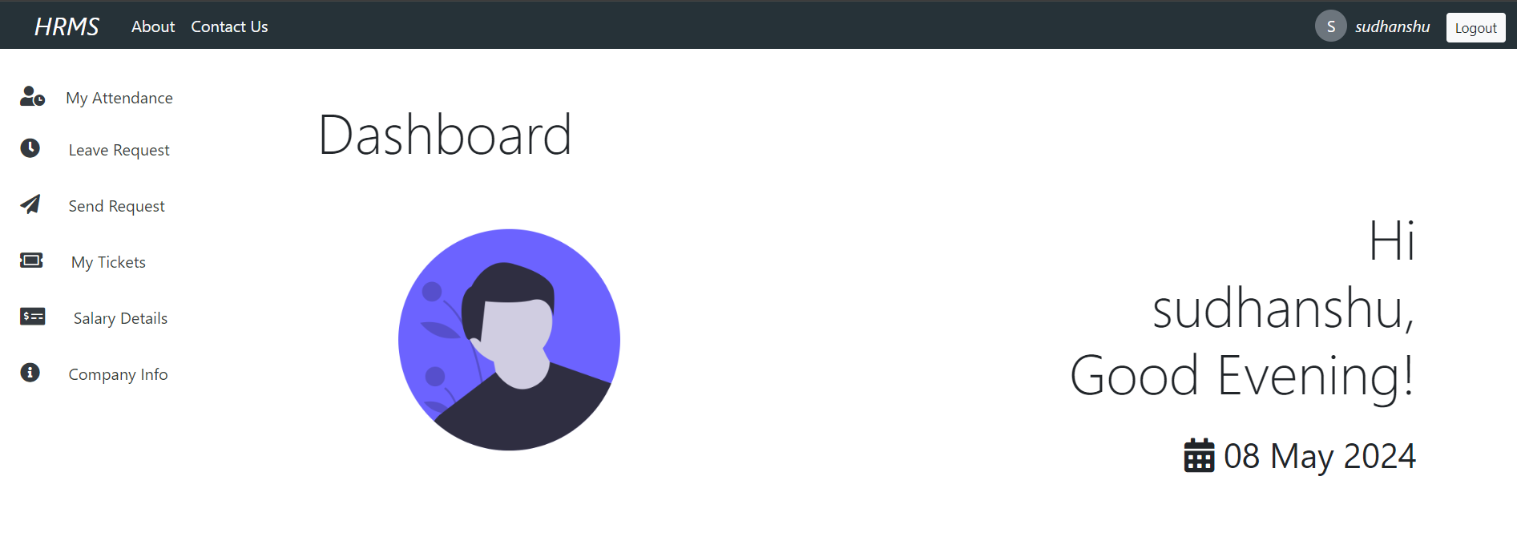
Employee

Slide 7
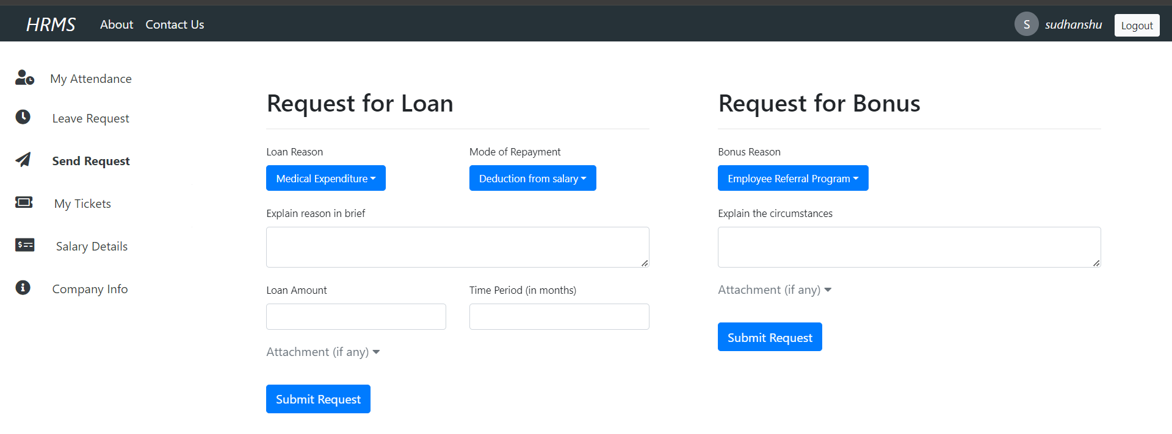
Leave, Loan and Bonus request Management

Slide 8
Working Details
This comprehensive HRMS enhances organizational efficiency, streamlines processes, and provides a seamless experience for both administrators and employees, catering to various aspects of HR management for improved productivity and engagement.
User Authentication: Secure logins for employees and admins.
Employee Management: Add, edit, delete employee records for centralized information.
Payroll System: Automated integration for accurate salary processing.
Leave and Benefits: Streamlined processes for leave, loan, and bonus applications.
Ticket Management: Centralized system for queries, tracking, and resolution.
Access and role mgmt: User registration with role assignment for access control.
Efficient Data Management: Quick search and modification of employee records.
Statistical Analysis: Admin dashboard for informed decision-making.
Google Calendar Integration: Reminders for HR-related tasks.

Slide 9
Scopes
Current Scope:
The "Human Resource Management System" project aims to develop a user-friendly, scalable HR solution catering to employee information management, payroll, leave applications, and ticket handling. Emphasizing adaptability, it targets streamlining HR processes for various organization sizes.
Future Scope:
Future plans involve integrating AI-driven analytics for performance evaluation, mobile app development, academic system integration, and analytics/reporting features. These advancements aim to enhance decision-making and accessibility, ensuring a more efficient and versatile HR management system.

Slide 10
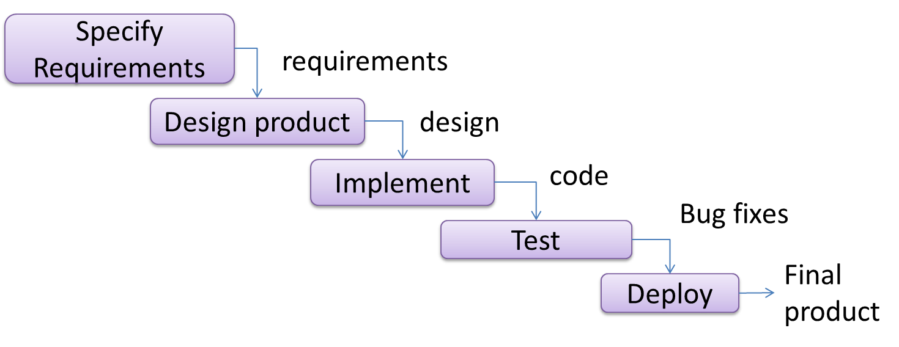
Methodology
Requirements Analysis: Identify specific needs for HR modules through stakeholder collaboration.
System Design: Plan architecture, data flow, and user interfaces, ensuring cohesive module integration.
Database Design: Create a robust schema for data integrity and efficient retrieval.
Development: Utilize ReactJs, Typescript, NodeJs, MongoDB, aligning with design specs.
Testing: Thorough testing for functionality and security through unit, integration, and user acceptance testing.
Deployment: Deploy HRMS on a web server, verify successful deployment, and address issues/bugs.

Slide 11
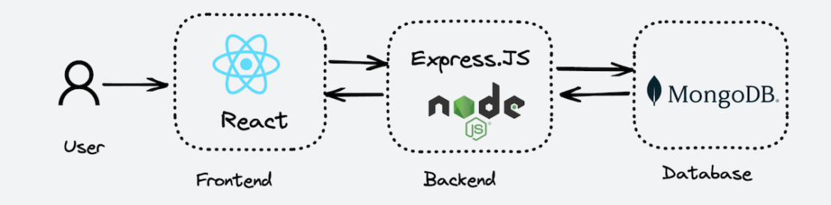
Resources and Limitations
Hardware Resources:
Web Hosting: Needs a web server to host the application, ensuring accessibility.
User Devices: Dependent on computers with internet access for user interaction and application utilization.
Software:
Front-end Development: Uses ReactJs and Bootstrap for user-friendly and responsive interfaces.
Server-Side Scripting: Relies on Node Js for strong server functionality and performance.
Database Management: Adopts MongoDB, ensuring scalable and efficient data management.

Slide 12
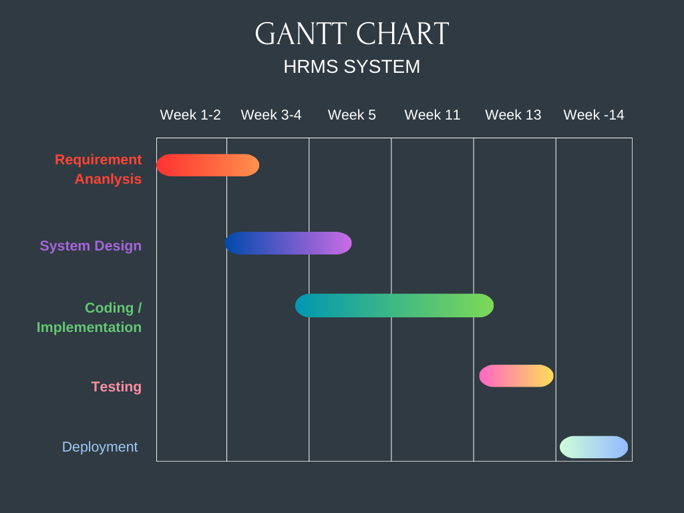
Project Timeline

Slide 13
Conclusion
HRMS Impact:
Automates tasks: employee management, payroll, ticket handling.
Features: user authentication, data management, Google Calendar integration.
Immediate Focus: Create scalable, user-friendly solution for all organizations.
Future Plans: Advanced analytics, mobile integration, comprehensive reporting.
Goal: Elevate decision-making.
Development Process:
Analysis, systematic design, iterative development.
Culminates in rigorous testing and deployment.
Resource Dependency: Essential hardware: web server, user-accessible computers.
Overall Aim: Optimize HR functions for accuracy, efficiency, adaptability.
Value Proposition:
Valuable asset for streamlined HR operations.
Enhances overall organizational effectiveness.

Slide 14
References/Bibliography
Reactjs: https://react.dev/ .
Nodejs: https://nodejs.org/ .
MongoDB: https://www.mongodb.com/docs/ .
Expressjs: https://expressjs.com/ .
VS code Editor: https://code.visualstudio.com/docs .
Bootstrap: https://getbootstrap.com/ .
Javascript: https://developer.mozilla.org/en-US/docs/Web/JavaScript .

Slide 15

Any Queries Or Feedbacks ?

